Slide 1
VisionDrive
Graham Haun

Slide 2
Goals
A model that could predict driving outputs through images
A model that understood basic driving
Success Metrics
Low Mean Squared Error (MSE) and Mean Absolute Error (MAE)
Predicted driving outputs that made sense based on the images

Slide 3
The Data
Udacity Self Drive dataset
5 trips taken in an Internal Combustion Engine (ICE) car that included image and input data
36 files of different inputs for each trip
33,782 images total
Challenges
Images were not matched to data
Many null values of inputs due to low image count
No data dictionary
Merging all data into one file

Slide 4
Approach To the Data
Determined features to use
Determined if data and images were in chronological order
Determine if all three cameras showed the same scene
Removed features not useful to the model
Attach image file paths to the input data
Rename features for better personal understanding
Merge files on image data file paths
Remove any nulls that occurred

Slide 5
The Model
Convolutional Neural Network (CNN)
Looks at a bunch of images and turns them into numbers
Looks for patterns like edges or curves
As the network goes deeper it recognizes more complex features
Puts all this information together to say this is probably a dog
Notes:
MaxPool2D: 2x2 grid goes through all activations and picks the max. cuts features in half
Batch Norm: standardizes data so it has a mean of 0 and a standard dev of 1. Good because it speeds up training and

Slide 6
Findings
Mean Squared Error (MSE): 36,235
Max Possible: ~ 2.4 million
Mean Absolute Error (MAE): 29.63
Max Possible: 1,562
Notes:
Over 2 mill for squared mean
1500ish for absolute mean

Slide 7
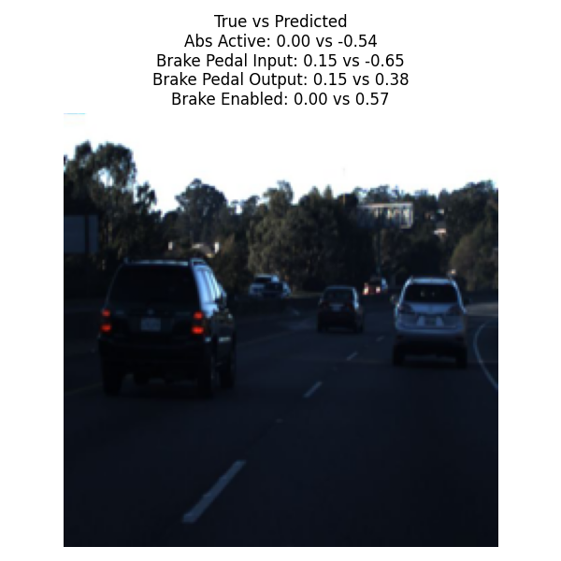
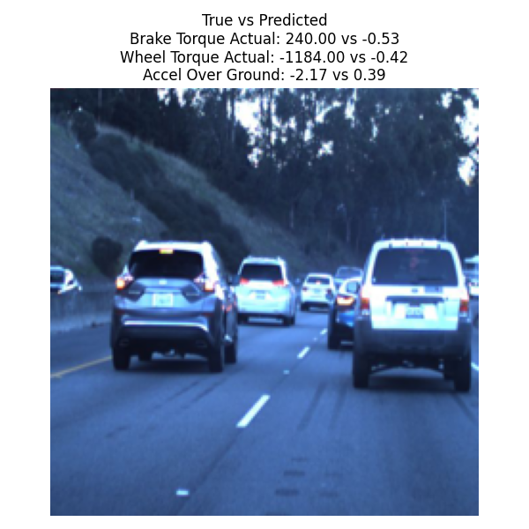
Braking Predictions

Slide 8
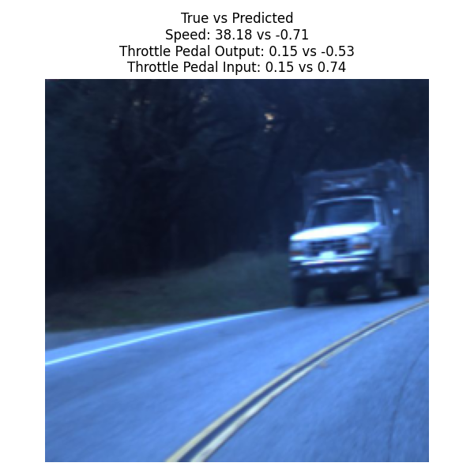
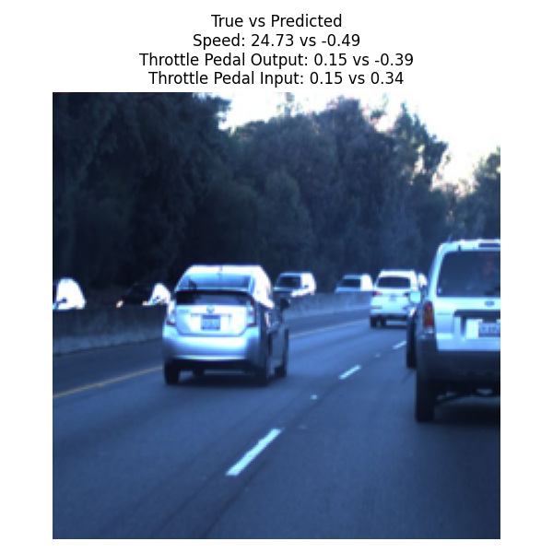
Speed Predictions
Speed in km/h

Slide 9
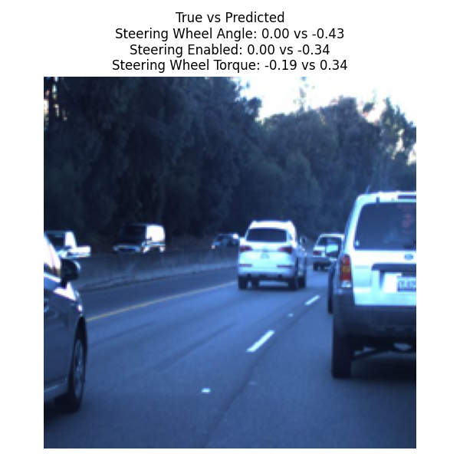
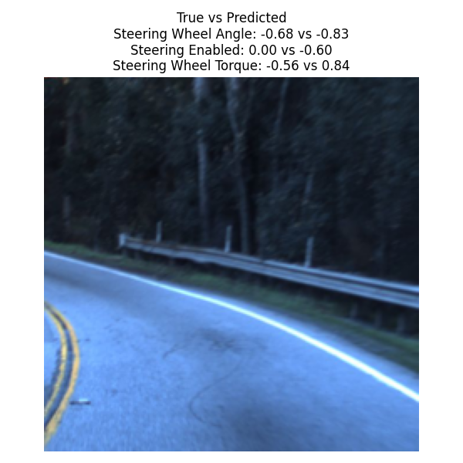
Steering Predictions

Slide 10
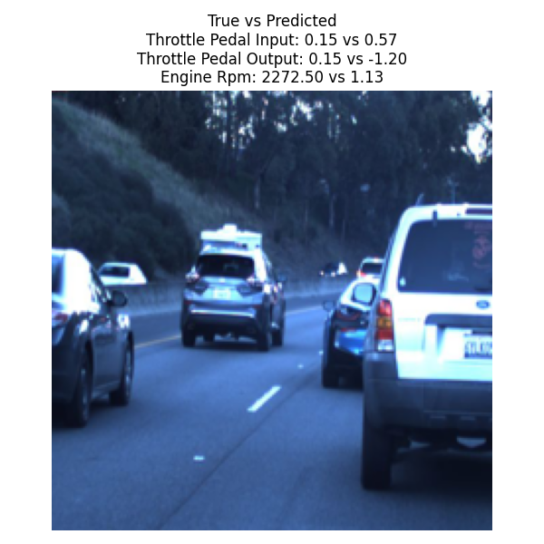
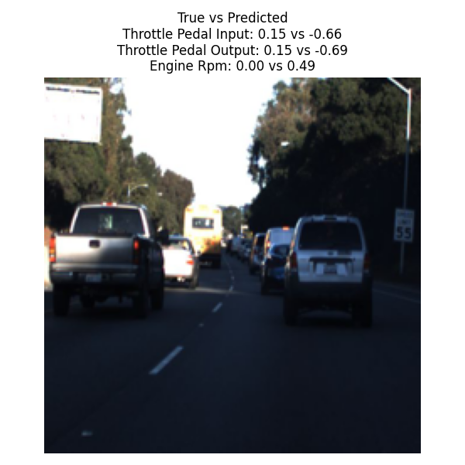
Throttle Predictions

Slide 11
Risks and Limitations
The model has no depth perception
Limited training environments
Next Steps
Add in LiDAR and sensor information
Train on a simulation

Slide 12
Thank You
Matt Brems
Asha Mathis
Udacity for the data
Perplexity AI

